Slide 1

Multi-class text classification of Cyberbullying tweet text
Submitted by – group 4
Abhisek kumar Shaw - FT221008 | Ashish Viresh Samant - FT221063 | Deep Sinha - FT221079 | Harsha Mangnani - FT222026 | Mandar Kandge - FT222064

Slide 2
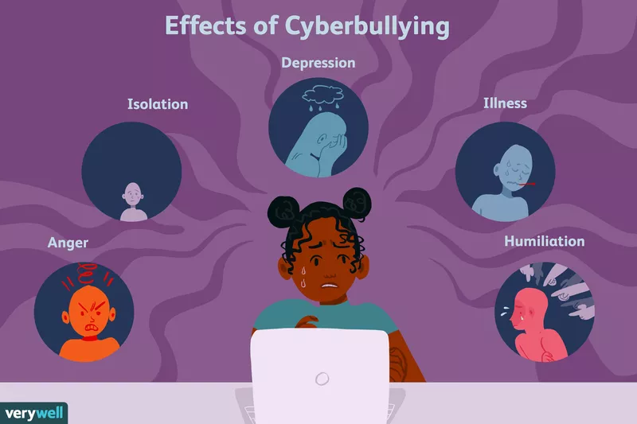
Cyberbullying and its effects
Bullying committed online is known as cyberbullying. Social media, chat services, gaming platforms, and mobile devices are all potential venues. It is a pattern of behaviour meant to frighten, infuriate, or embarrass those who are the target.
Nowadays social acceptance among teens is a very important part of adolescent experience. According to Teensafe.com 87% of teens have witnessed some form of cyberbullying and 34% have been the actual victims.
The effects can last a long time and affects a person mentally, emotionally and physically.

Slide 3
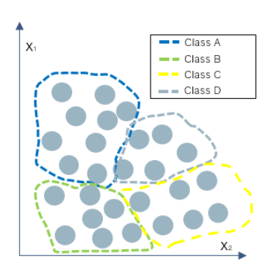
MULTICLASS TEXT CLASSIFICATION
The two subfields of AI are Machine learning and Natural Language Processing. The text classification problem belong to the branch of NLP and can either be ML based or not.
If each class of data is mutually exclusive and easily distinguishable then the task is called multi-class text classification. Each data point must belong to one class only.
Text classification is used to predict sentiment in a sentence or tweet or to differentiate the emails and to detect the level of toxicity

Slide 4
NLP PIPELINE
DATA COLLECTION
TEXT CLEANING
PRE-PROCESSING
SPLIT THE DATA INTO TRAIN TEST AND VALDIATION
DEPLOYMENT
EVALUAUTION
MODELLING
FEATURE ENGINEERING

Slide 5

MODELLING TECHNIQUES
Models are generally approximations of real world object and a good model is one which accurately predicts the behaviour of real world artefacts. In our project we’ve used a total of 4 modelling techniques.
Support vector machine (SVM)
Long Short-term Memory (LSTM)
Convolutional Neural Network (CNN)
Naive Bayes

Slide 6
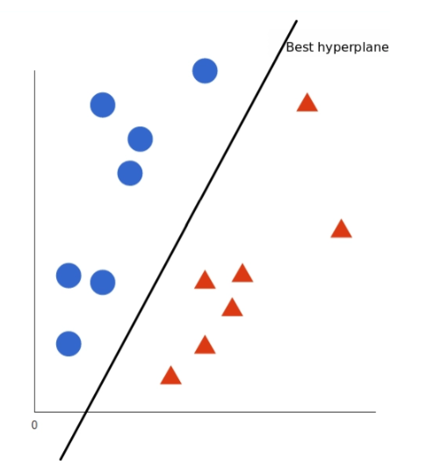
Support Vector Machine (SVM)
It is supervised machine learning models that uses classification algorithms for two group classification problem. It performs well with limited amount of data, this makes the algorithm very suitable for text classification.
Let’s say the data have two features X and Y and we have two tags blue and red. We want a classifier that classifies the coordinates either blue or red.
This line is the decision boundary, any thing falls below the line is classify as red and above the line is blue.

Slide 7
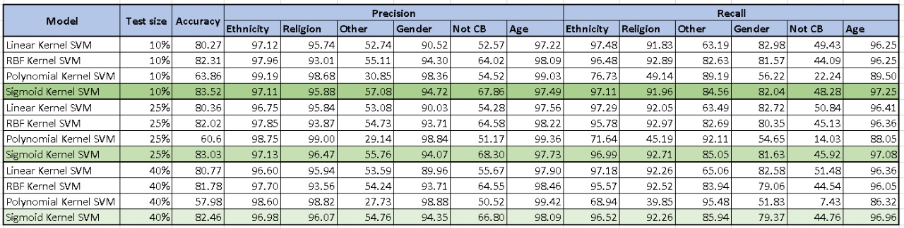
SVM RESULTS

Slide 8
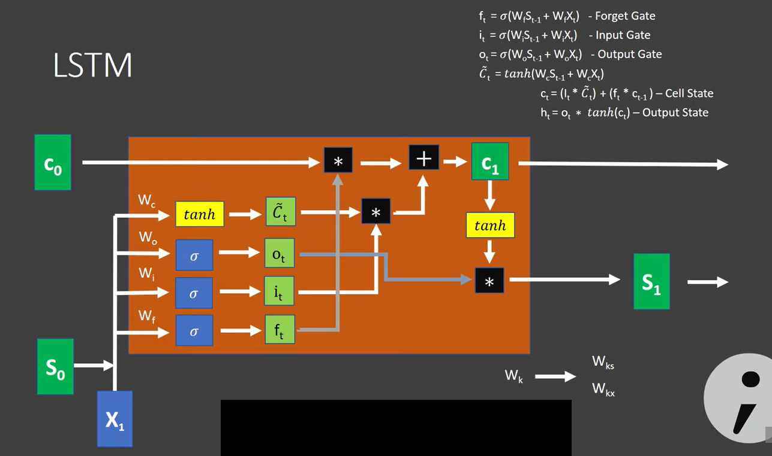
Long short-term memory (LSTM)
It is a kind of recurrent neural network, the output from last step is fed as input in current step. LSTM tackled the problem of long term discrepancies. LSTM can by default retain the information for long period of time.
It has a chain like structure that contain 4 neural network and different memory blocks. Information retention is done by cells and memory manipulation is done by gates(Forget, Input and Output gate).

Slide 9
Lstm RESULTS

Slide 10
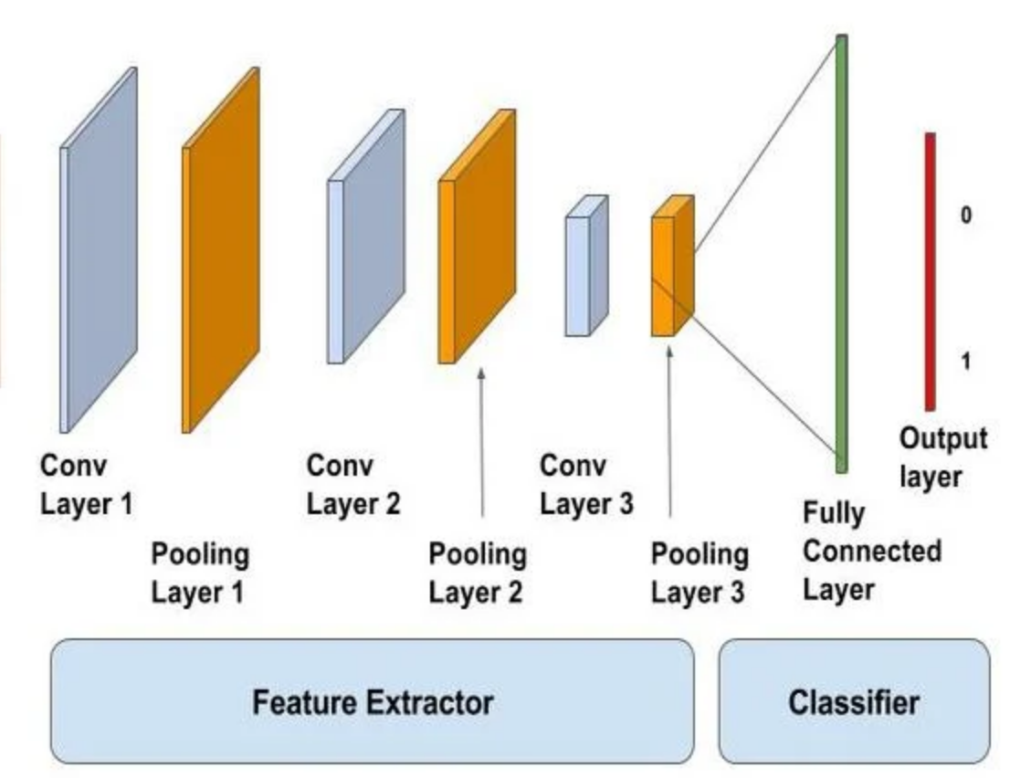
Convolutional neural network (CNN)
It is an deep learning algorithm which can take image/words as an input, assign weights and biases to object in the image and be able to differentiate one from the other. CNN requires very less pre-processing compared to other classification algorithms.
i/p text

Slide 11
CNN Results

Slide 12
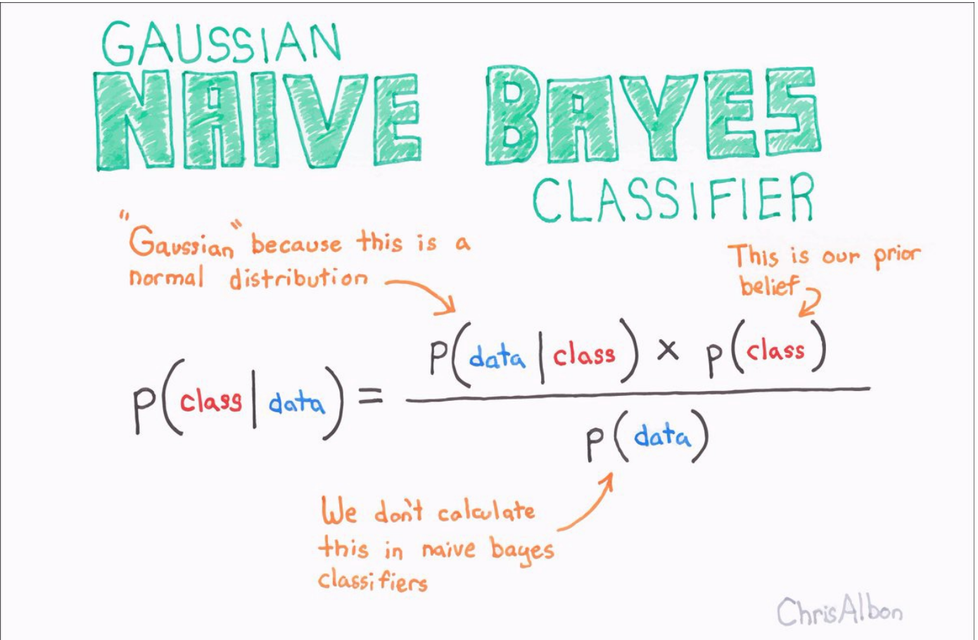
NAIVE BAYES
Naïve Bayes algorithm
supervised learning algorithm,
based on Bayes theorem and
used for solving classification problems
It predicts on the basis of the probability of an object.
Naïve: Because it presumes that the presence of one trait is unrelated to the occurrence of other features, it is known as naive. A red, spherical, sweet fruit, for instance, is recognised as an apple if the fruit is identified based on its colour, form, and flavour. So, without relying on one another, each characteristic helps to recognise it as an apple.
Bayes: It is called Bayes because it depends on the principle of Bayes' Theorem.

Slide 13
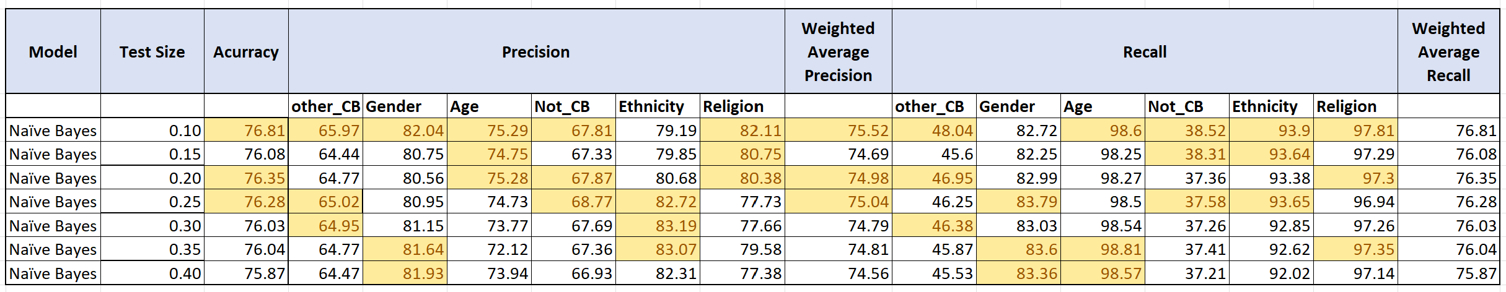
NAÏVE Bayes results

Slide 14





SAMPLE OUTPUT

Slide 15
BUSINESS INSIGHTS/Applications
Protecting teenagers from cyberbullying.
Detecting cyberbullying text on various social media platforms.
Checking the level of toxicity of tweets to enable prompt action.
Locate the region with high amount of toxic tweets and take preventive measures beforehand.
Prevent riots by takin action for gender, religion and ethnicity related cyberbullying to stop it from spreading.

Slide 16
Future scope of work
DEPLOYMENT OF THE MODEL FOR VOICE SPEECH DETECTION AND TRAINING THE MODEL FOR HATE SPEECH DETECTION
In Future, this can be used to check for toxicity or hate speech detection from a saved video file, and understand the sentiment behind the speech.
DEPLOYMENT OF THE MODEL CONNECTING IT TO TWITTER API FOR PARTICULAR ANTI-CYBERBULLYING GROUPS AWARD TO DETECT CYBERBULLYING
The model when linked with API accounts of various anti-cyberbullying groups such as ‘Anti-Bullying Pro’, ‘StopBullying.Gov’ etc. Can help these organisation track down cyberbullying and take preventive and corrective action.
TRAINING THIS MODEL FOR CYBERBULLYING TEXT FROM VARIOUS OTHER SOCIAL MEDIA PLATFORMS.
Training this model for cyberbullying text detection and classification can help in better generalization and accuracy of this model.

Slide 17
REFERENCES
https://odr.chalmers.se/bitstream/20.500.12380/302526/1/GellermanBrask_2021.pdf
https://www.unicef.org/end-violence/how-to-stop-cyberbullying#2
https://monkeylearn.com/blog/introduction-to-support-vector-machines-svm/
https://www.geeksforgeeks.org/deep-learning-introduction-to-long-short-term-memory/
https://towardsdatascience.com/a-comprehensive-guide-to-convolutional-neural-networks-the-eli5-way-3bd2b1164a53
https://medium.com/voice-tech-podcast/text-classification-using-cnn-9ade8155dfb9

Slide 18

Thank You

